Slide 1
BEHAVIOR MANAGEMENT IN PEDIATRIC DENTISTRY
Hiyam S. Ahmed

Slide 2
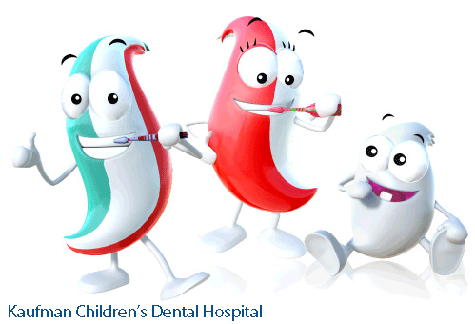
Introduction

Slide 3
Behavior management
Behavior management
Means by which dental health team effectively and efficiently provide treatment for a child and at the same institute a positive dental attitude .
■ Age
■ Dentist
■ Maternal Anxiety
■ Past Medical History
■ Time and Length of Appointment
■ Patient Awareness of Problems
Variables Influencing Behavior

Slide 4
Establishes effective communication with the child.
Objectives:-
Gains child’s confidence and acceptance of dental treatment.
Provides a comfortable environment for the dental team to work in.

Slide 5
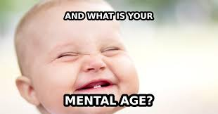
Age of The Pediatric Patient
Chronologic age
• The child's actual age in terms of years and months.
Mental age
• The child's level of intellectual capacity and development.
Emotional age
The child's level of emotional maturity.

Slide 6
Triad of Relationship
The situation is more complex in children’s
dentistry. The dentist (and other members of the dental
team)must also communicate with the parent(s) and the
child may receive information from more than one
source.

Slide 7
Triad of Relationship
Child patient
society
parent
Dentist

Slide 8
Classification of child’s behaviour observed in dental clinic

Slide 9
Wilson’s classification(1933):
1. Normal\Bold: brave, co-operative, friendly
2. Tasteful\Timid: shy, does not interfere
3. Hysterical\Rebellious: temper-tantrums
4. Nervous\fearful: tense, anxious and fears

Slide 10
Frankel’s classification(1962):
1. Def –ve :refuses, cries, associated with fear.
2. – ve : reluctant and slight negativism
3. + ve : accepts, bad experience
4. Def +ve : unique , looks forward, understands importance of treatment

Slide 11
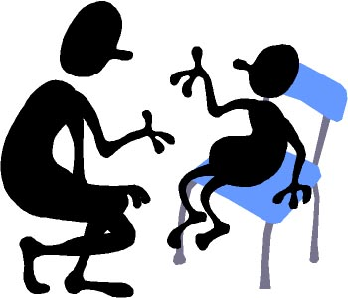
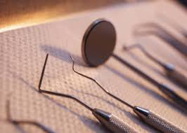
Behavior management techniques

Slide 12
Non pharmacological approach:-
Tell-show-do
modeling
Positive and negative reinforcement
distraction
Voice control
Hand over mouth technique
Physical immobilization

Slide 13
Pharmacological approach:-
Oral premedication (conscious sedation)
Nitrous oxide sedation
General anesthesia

Slide 14
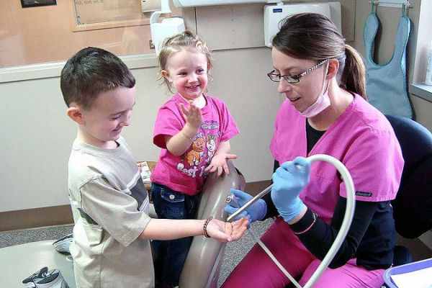
B-Methods:
Tell-show-do
(TSD)
(Tell) describe to the child
(show) demonstration for the patient different aspects of the procedure in a non-threating setting
(do) then proceed to complete the procedure

Slide 15
Use of euphemisms:
Dental terminology | Word substitute
Probe | Tooth feeler\counter
LA | Sleepy water for tooth
SSC | Cow boy hat
Silver filling | Silver soldier
Rubber dam | Rain coat
Hand piece | Tooth whistler
radiograph | Tooth photo
Rubber dam clamp | Tooth button

Slide 16
Dental terminology | Substitute words
High speed suction | Vacuum cleaner
Air syringe | Wind
Bur | Brush or pencil
Caries | Sugar bugs
Prophylactic paste | Special tooth paste
Rubber dam frame | Coat track
Band | Ring for tooth
X-ray equipment | Camera
sealant | paint

Slide 17
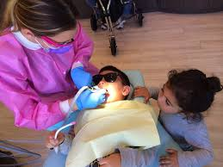
B-Methods:
Modeling
This method allows the child to observe one individual who demonstrate appropriate behavior in the dental setting.
Stimulated models as films clips or videos shows can be used to reinforce the desired behavior.

Slide 18
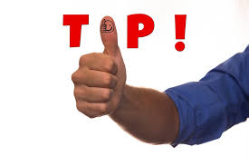
Reinforcement
Reinforces can be:-
Materials-toys
Social-praising, positive facial expression

Slide 19
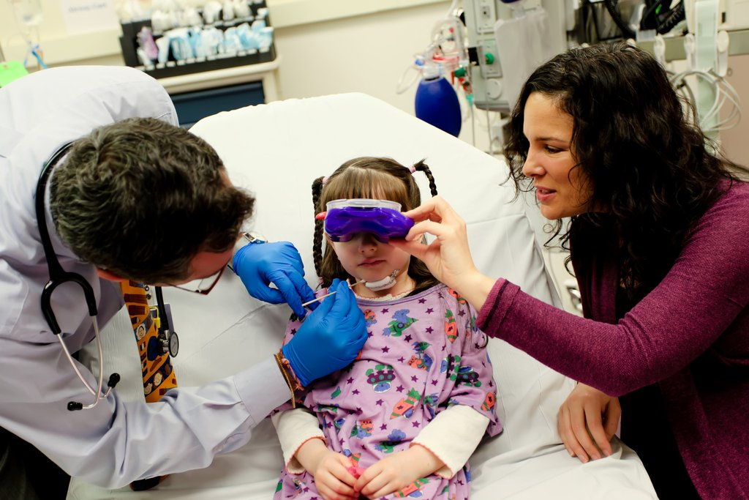
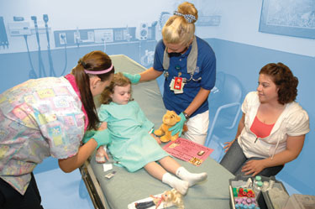
distraction
It is a technique used to divert the patient’s attention during the unpleasant procedure such as video tapes.

Slide 20
Voice control
It is a controlled alteration of voice volume, tone to:-
Gain the patient’s attention
Establish authority
It is indicated for uncooperative children

Slide 21
Hand over mouth
This method is establish communication with children who are able to cooperate, but exhibit a hysterical behavior to avoid treatment.
A hand placed over the child’s mouth and is told that the hand will be removed as soon as appropriate behavior begins.
When the child responds, the hand is removed and the praised for his appropriate behavior

Slide 22
H.O.M.
Indications:
Screaming – difficult to establish communicn
All forms failed
> 3 yrs old
Who resist treatment
Un-controllable behaviour

Slide 23
Physical immobilization
Immobilization by dentist/staff/parents
Physical restraints (papoose board)
Are user to provide partial or complete immobilization of the patient to protect the patient and dental staff from injury while providing dental care.

Slide 24
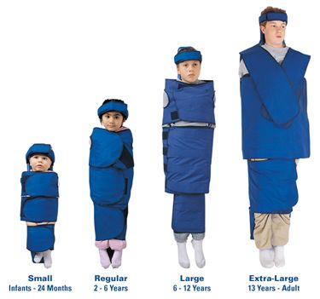

Slide 25
Pharmacological approach

Slide 26
Conscious sedation:-
Tablets
Syrup
Quite drowsy and may even fall asleep, but they will not become unconscious.

Slide 27
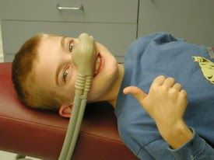
Nitrous oxide:-
Oxygen and nitrous oxide:-
Oxygen and nitrous oxide is given through a small breathing mask.
Relax, but without putting them to sleep.
Very safe and effective

Slide 28
Thank you

